Slide 1

AI Trend Detection in Healthcare by applying Topic Clustering and Sentiment Analysis using Podcast Data
Intro Talk Master Thesis: Tim Löhr, B. Sc.
Advisors: Philipp Dumbach, M. Sc., Leo Schwinn, M. Sc., Prof. Dr. Björn Eskofier
Machine Learning and Data Analytics (MaD) Lab
Friedrich-Alexander-Universität Erlangen-Nürnberg (FAU)
2022-01-19

Slide 2





AI impacts numerous industries
AI
[1]
Stocks
Education
Healthcare
Retail
Fashion
Notes:
Ai is sneaking more and more into different industry fields with an increasing impact. For example in the educational sector, AI is already used as intelligent tutoring system, by tracking the childrens pupils and enhancing their concentration accordingly. Personally, I find the healthcare sector very interesting. Ai is already used for an improved diagnosis of diseases, for a faster process of drug research and approval and also for pattern recognition in genoms to identify potential risks for certain diseases.

Slide 3





The most popular platforms
Notes:
Those different application fields of AI in healthcare are not only discussed behind shut doors, but the discussions are also recorded and published on popular podcast platforms. People are interested in listening to experts discussing advances in their research fields. Podcasts are an emerging market. They quickly are rising in popularity on an annual basis.

Slide 4
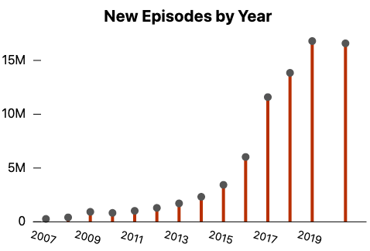
Rising popularity and production
[3]
550k Podcasts
18.5 million Episodes
463.5 Terabyte
June 2018
[2]
2.000k Podcasts
48 million Episodes
1.2 Petabyte
April 2021
[2]
Notes:
For example apple podcasts. The amount of produced podcasts doubled within 3 years from 2018 to 2021.

Slide 5



How to predict the trend?
API
NLP
Podcasts
Speech-to-Text
Trend Detection
Notes:
We now identified that podcast is a rich source of data with an increasing production rate. In order to make use of this huge amount of data, we first need to transcribe the voice into text. Only after having transcribed all of the voices into text files, we can make inference and predict future or past trends with the use of natural language processing.

Slide 6
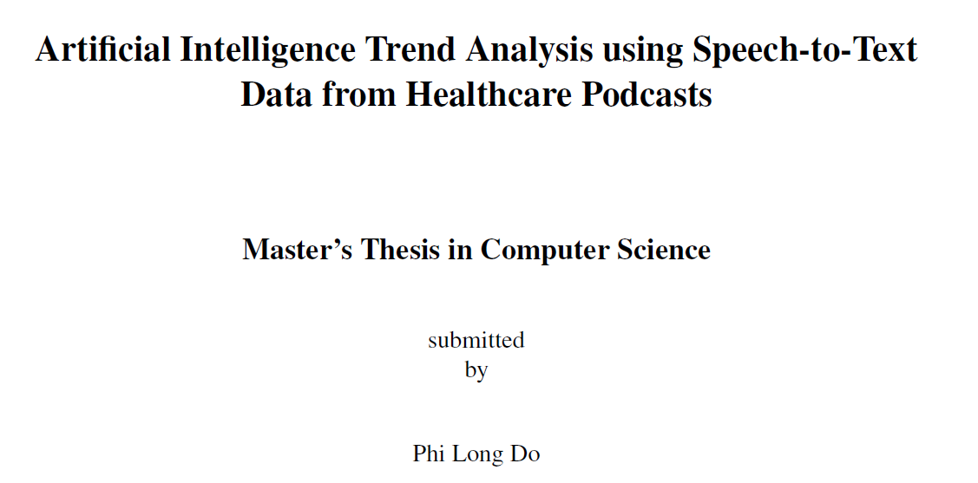
Related Work – Part l
Podcasts
30 Healthcare Podcasts
Episodes
~ 1500 Episodes
Date
2010 to 2021
Research Gap
Predict Future AI Trends with
Qualitatively better transcriptions (lower word error rate)
Increased data set
Improved and extended keyword list
Notes:
A first attempt to detect the trends of AI in healthcare has already been conducted by Long do et. al as a masterthesis last year at the madi department. He identified the 30 most important healthcare podcasts and built a pipeline to download and transcripe the podcasts with different technologies. Long Do concluded that in order to make better predictions of the trends, different angles need to be taken care of. This is where my masterthesis builds upon. Due to the exponential growth of podcast production, I can collect more data. The keywords are used to evaluate the trend prediction. Long used different sources to build the keyword list, but other techniques could be used to create a better keyword list

Slide 7
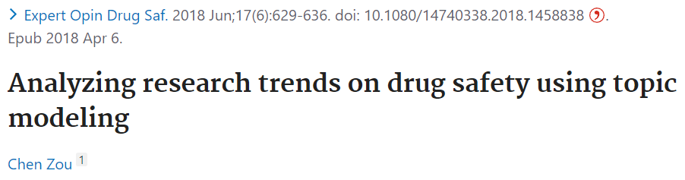
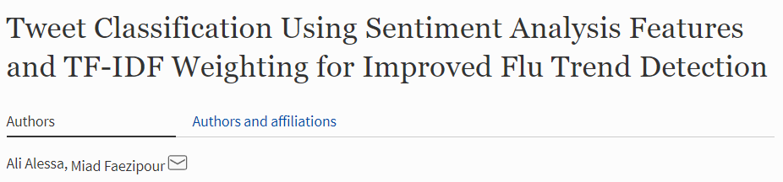
Related Work – Part ll
Topic Clustering
Sentiment Analysis
Large scale sentiment analysis of tweets
Successful early detection of flu with sentiment analysis features
Identification of 50 main topics
Identified trends by temporal popularity
Found dynamic patterns in medical topics over time
[5]
[4]
Notes:
Long at. al and other sources conclude that sentiment analysis and topic clustering could be good techniques to improve the trend detection. I found out that research on both subjects has already been conducted to identify trends or find new topics, aka keywords

Slide 8
Research Questions
RQ 1: Is there a qualitative difference between the open-source speech-to-text API's DeepSpeech
and Vosk by evaluating their language models and their Word Error Rate (WER) metrics?
RQ 2: Is topic clustering a suitable approach for identifying keyword clusters and investigating the relationship of the keywords for enhanced AI trend analysis?
RQ 3: Is it possible to predict the speakers' sentiments towards specific AI-related keywords by
applying sentiment analysis?
Notes:
My research questions can therefore be concluded into

Slide 9

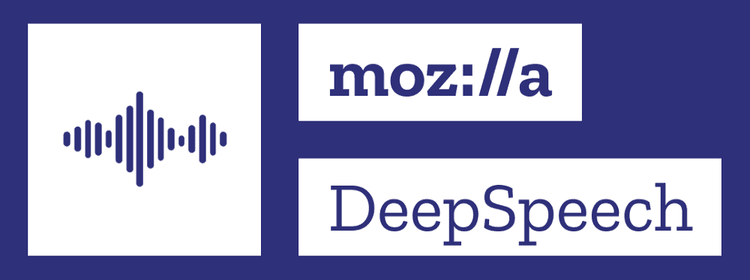

Measuring the Word Error Rate (WER)
.wav snippet
Deepspeech
Deepspeech WER
Human Transcription
Podcasts
Speech-to-Text
Word Error Rate
Vosk WER
Notes:
The first method, to find the best working speech to text transcriber is to calculate the word error rate for sample audio snippets with a human transcriped label. Long do identified the best two open source (free) tools, namely vosk and deepspeech. I will conduct a comprehensive evaluation on which tool is currently performing better and choose it accordingly to transcripe my 750 GB of podcast data.

Slide 10
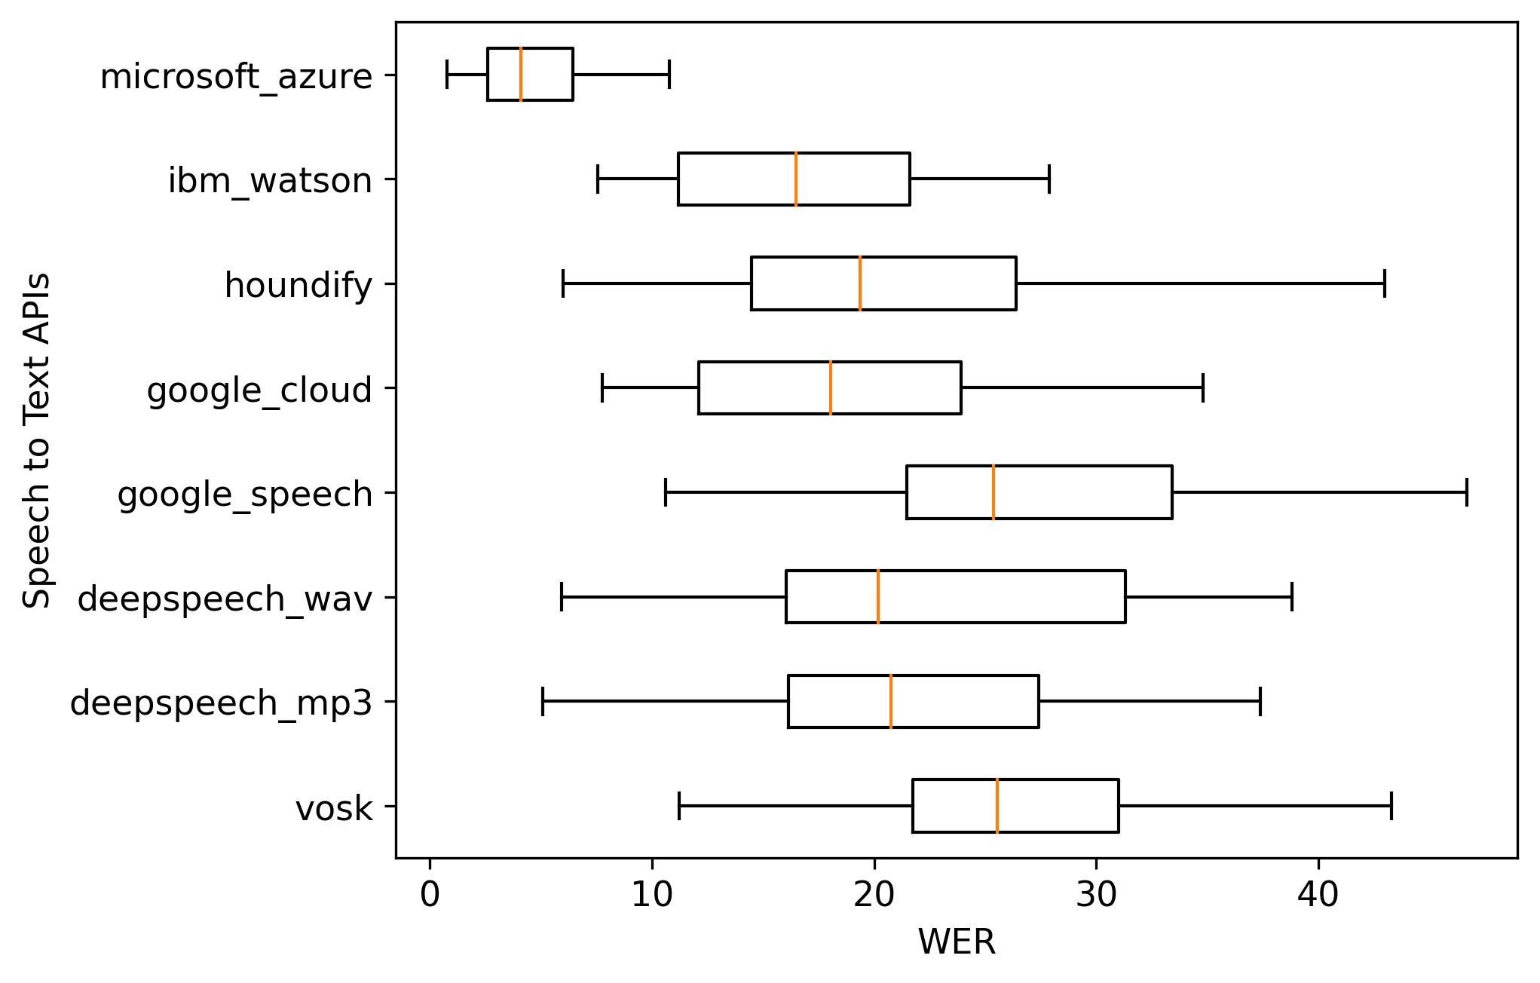
Prior WER Results
Computed on 30 snippets with an average length of 50 seconds each
Best performing API among all tested APIs: Microsoft Azure
Best performing API among free to use APIs: Mozilla DeepSpeech
[3]
Notes:
Here we can see the reference error rates of Long do. Among all speech2text apis, azure performed the best, but is not for free. The only free open source apis are deepspeech and vosk

Slide 11
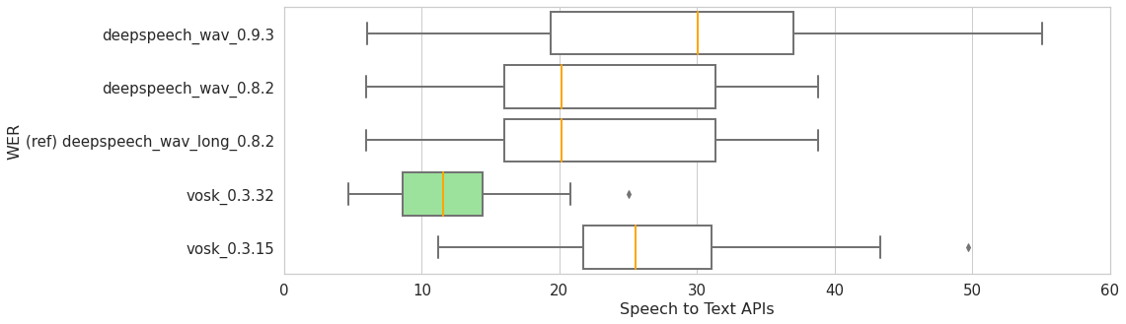
Preliminary WER Results
Notes:
A first evaluation on the newer versions show two interesting developments. I accelerated my gpu to generate the speech to text outputs with the latest versions of deepspeech and vosk and then the word error rate was calculated accordingly with the human transcription as label. Interestingly we can observe that the latest deepspeech version performed worse than the older version, but the latest vosk version showed an significant improvement of text transcription.

Slide 12
Detecting the trend with an extended keyword list
Keyword List
ML Glossaries
ML Hype Cycles
AI Hype Cycles
CS / IT Dictionaries
Sentiment Analysis
Topic Clustering
Trend Detection
Keyword occurrence
Sentiment
Scenario planning
Notes:
To leverage now all of the transcribed data, a keyword list is needed as label for the trend detection. Long do et. al put the list together with the use of the gartner hype cycle and the google ml glossary. As other researchers concluded, sentiment analysis and topic clustering could now further improve the detection. The sentiment from the people speaking in the podcast in combination with the keywords could be used to conduct a scenario planning method, as practinioned by social scientists. I am trying to find out the best method to make a good trend detection.

Slide 13

Roadmap Month
Literature Research
1 - 2
Comparison of WER for Vosk and Deepspeech Versions
1 - 2
Update and Transcription of Podcasts
1 - 2
Creation of Keyword List
2 - 3
Trend Detection and Evaluation
3 - 5
Writing the Thesis
4 - 6

Slide 14
References
[1] pwc: No longer science fiction, AI and robotics are transforming healthcare https://www.pwc.com/gx/en/industries/healthcare/publications/ai-robotics-new-health/transforming-healthcare.html, June 2017, accessed: 2022.1.12
[2] Ross Winn: 2021 Podcast Stats & Facts, https://www.podcastinsights.com/podcast-statistics/, 2021.12.28, accessed: 2022.1.12
[3] Phi Long Do et. al.: Artificial Intelligence Trend Analysis using Speech-to-Text Data from Healthcare Podcasts, Machine Learning and Data Analytics Lab, Friedrich Alexander University Erlangen-Nürnberg, 2021.2.24
[4] Ali Alessa and Miad Faezipour: Tweet Classication Using Sentiment Analysis Features and TF-IDF Weighting for Improved Flu Trend Detection, Springer Professional, 2018
[5] Chen Zou: Analyzing Research Trends on Drug Safety using Topic Modeling. Expert opinion on drug safety, PubMed, June 2018

Slide 15
Thank you for your attention. Any questions?

